Slide 1
HOSPITAL MANAGEMENT SYSTEM
Edwin Arun
Ardra S B
Aneeta P T
Kishore L
Sona Goji

Slide 2
INTRODUCTION
Hospitals manage multiple operations daily: patient registration, appointments, bed allocation, billing, and record keeping.
Manual handling of these tasks often leads to inefficiencies, errors, and delays in patient care.
The Hospital Management System (HMS) automates these processes using a menu-driven terminal interface.
Implements role-based access control to ensure security and task-specific functionality for each user.
Enhances operational efficiency, reduces paperwork, and improves accuracy in hospital workflows.

Slide 3
OBJECTIVE
Automate hospital workflows to reduce manual effort.
Ensure role-based access for security and efficiency.
Improve patient experience through faster and accurate services.
Maintain structured and secure patient records.
Enable scalability for future digital healthcare solutions.

Slide 4
ABOUT
A terminal-based application designed for hospital management.
Supports three roles: Receptionist, Doctor, Billing Staff.
Provides role-specific functionalities for smooth operations.
Focuses on simplicity, speed, and accuracy in hospital processes.
Built with modular design for easy and future upgrades.

Slide 5
PROJECT DETAILS
Platform: Menu-driven terminal interface.
Technology Stack: Java, OOP principles.
Data Handling: Secure and structured patient records.
Access Control: Role-based access system.
Validation: Input checks to prevent invalid entries.

Slide 6
MAJOR MODULES
Receptionist:
Add patient details.
Book appointments and issue tokens.
Allocate beds based on category.
View patient details.
Doctor:
View appointment schedules.
Update appointment status.
Access patient information.
Billing Staff:
Generate bills based on services.
Deallocate beds after discharge.

Slide 7
ROLES
Edwin – UI, Validation, Testing
Ardra – Appointment module
Aneeta – Bed management, Billing module
Kishore – Doctor module
Sona – Patient management module

Slide 8
DURATION
Starting date – 3rd November 2025
Ending date – 4th November 2025
Total Duration – 2 Days

Slide 9
APPROACH
Requirement Gathering & Analysis
SRS Completion
Develop modular code for each role.
Integration and Testing
Deployment and documentation.

Slide 10
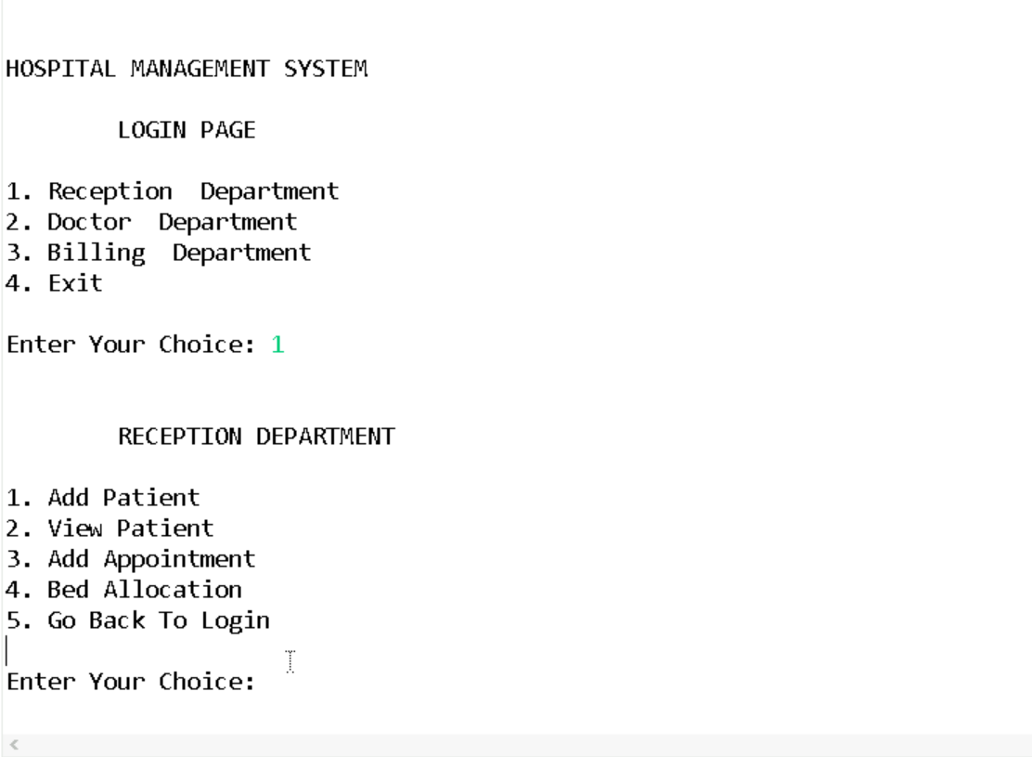
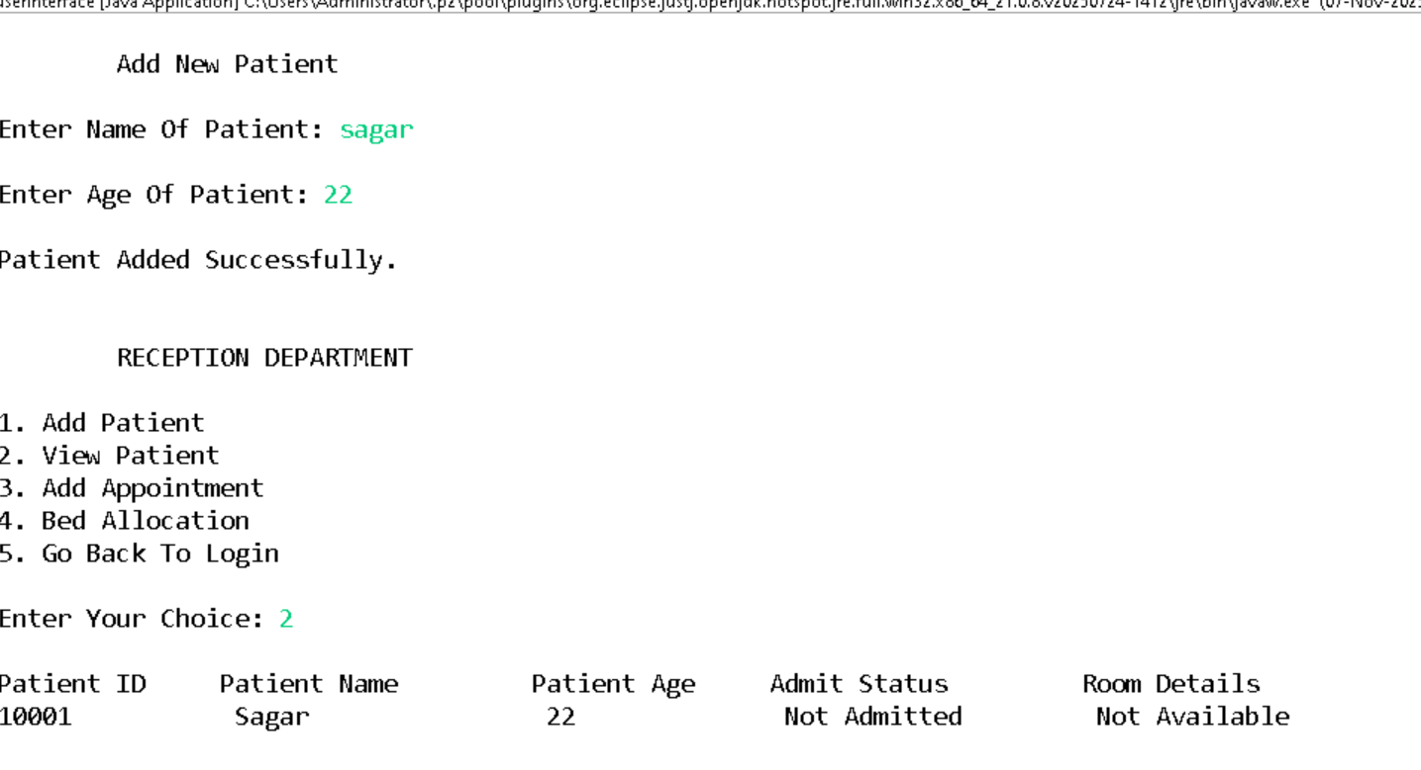
SCREENSHOTS

Slide 11
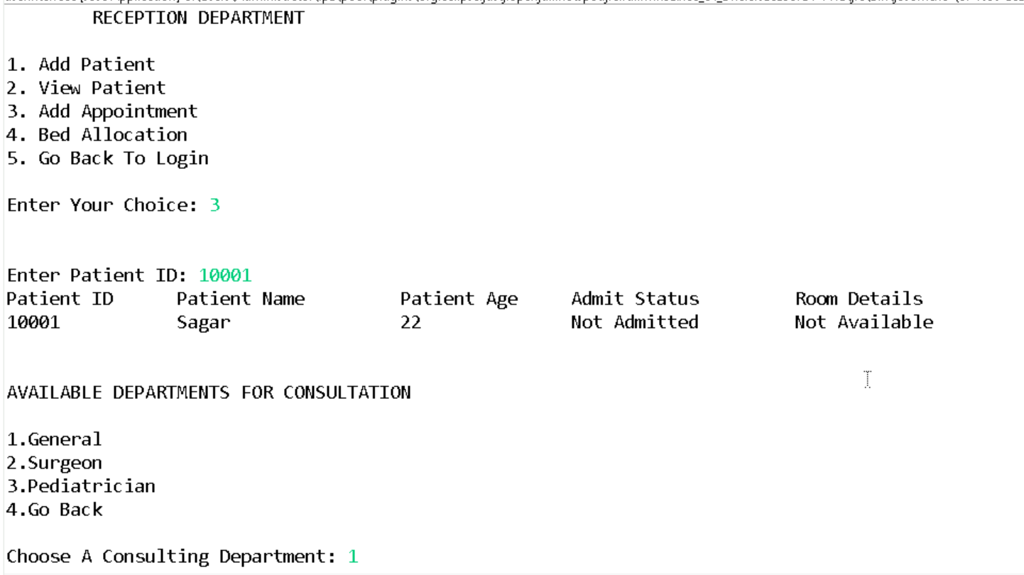
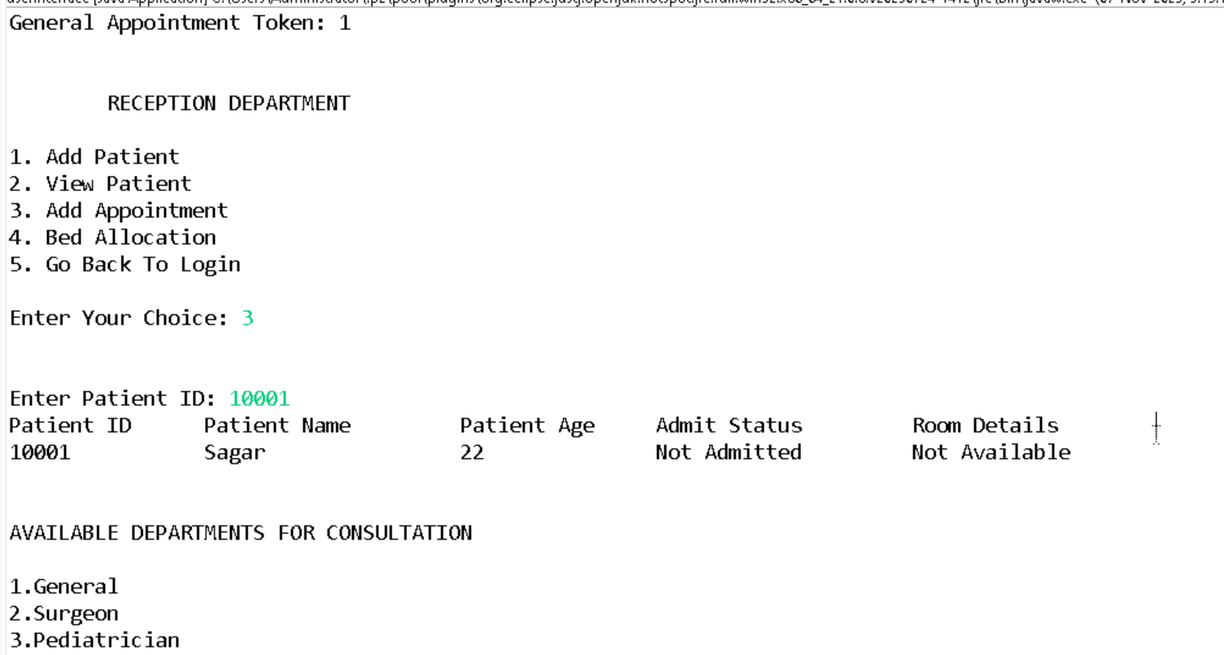

Slide 12
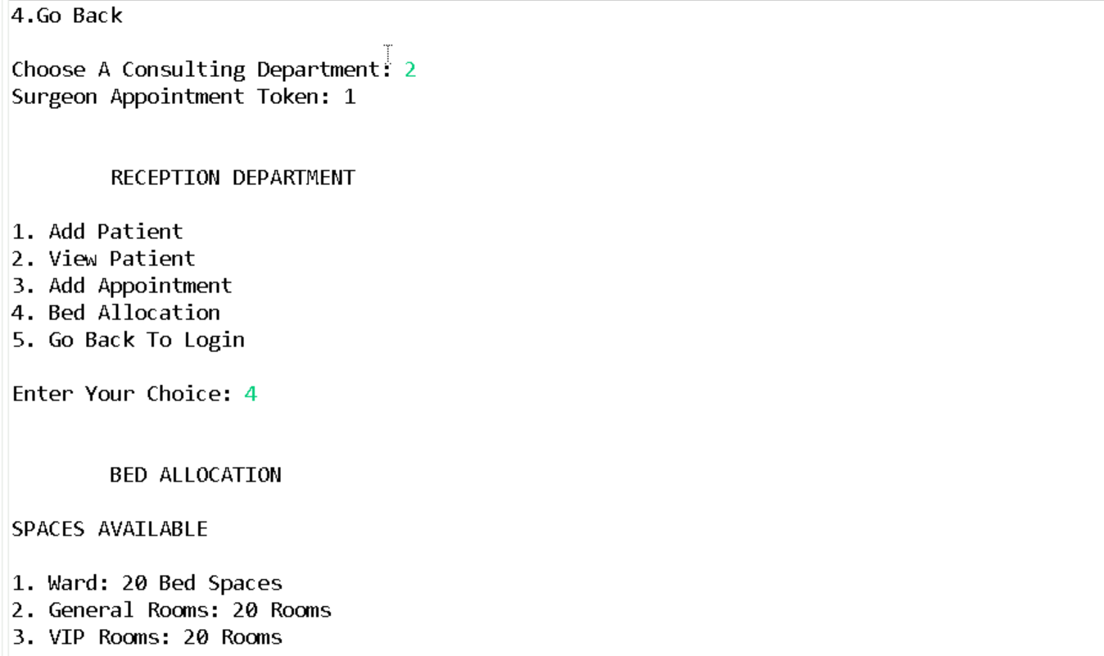
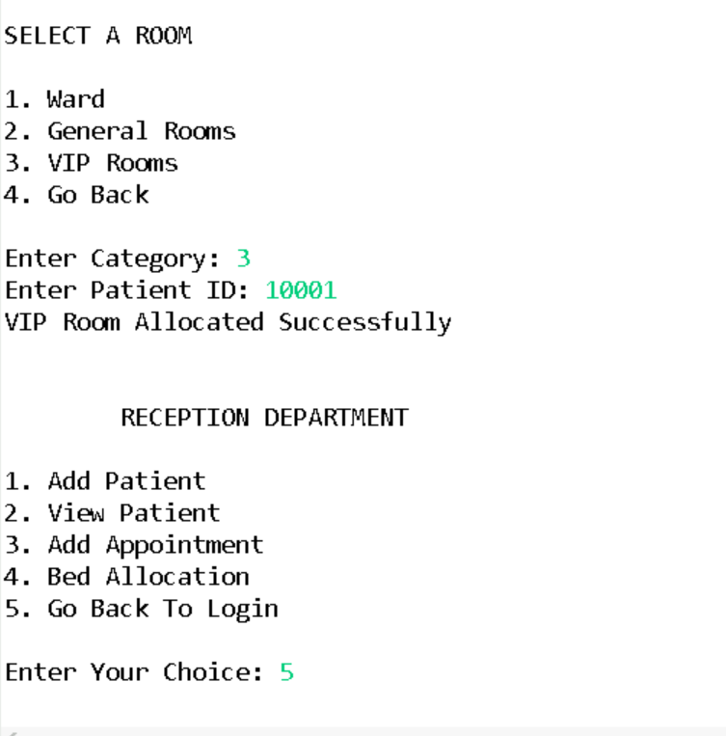

Slide 13
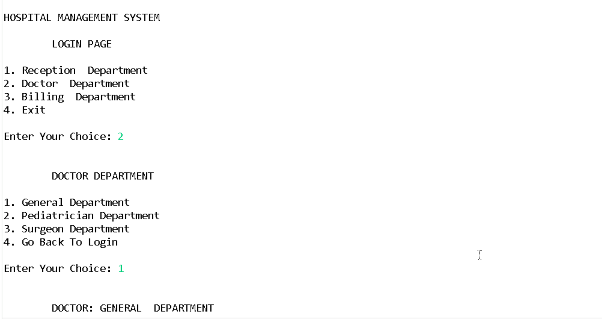
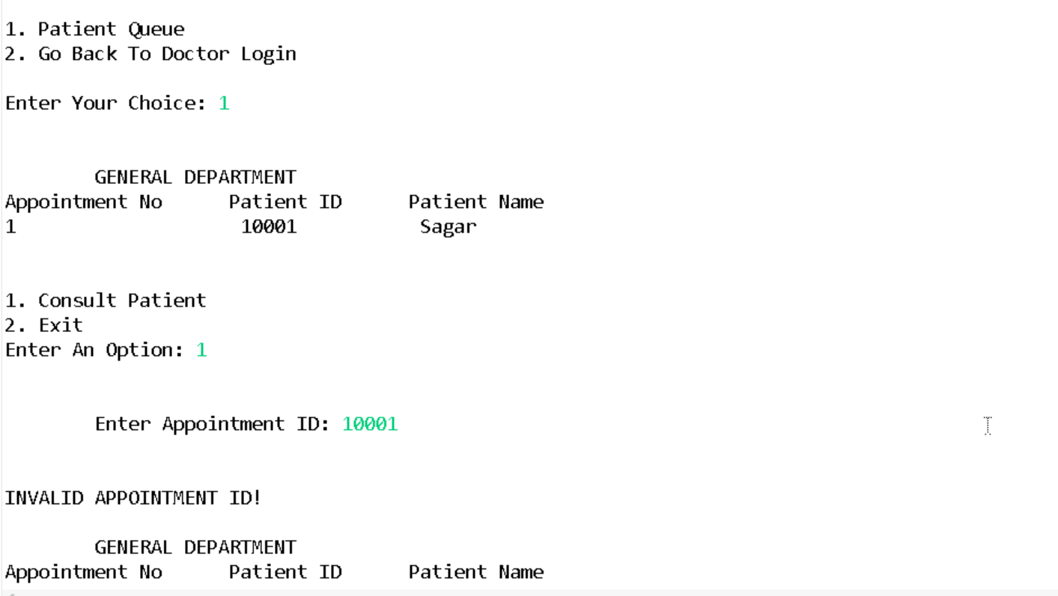

Slide 14
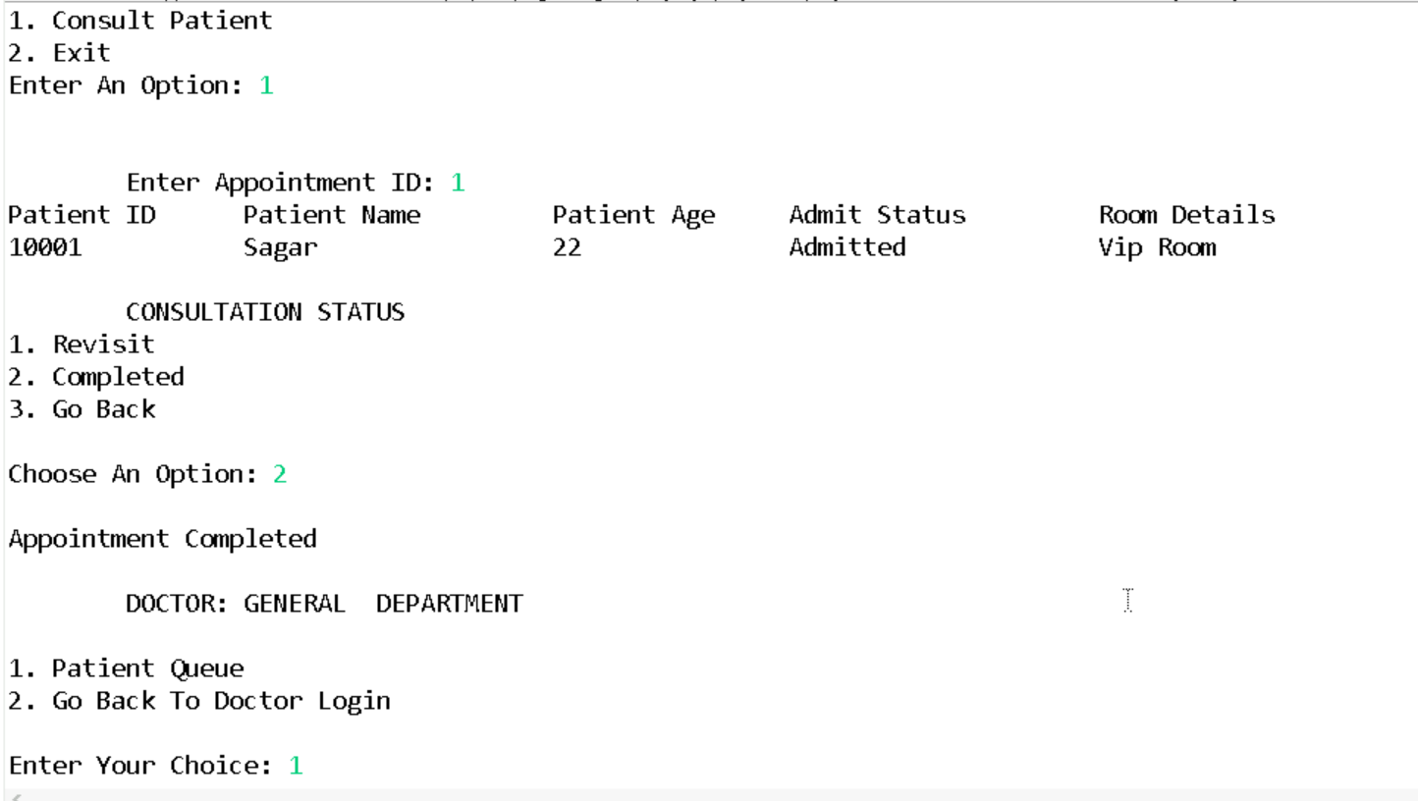
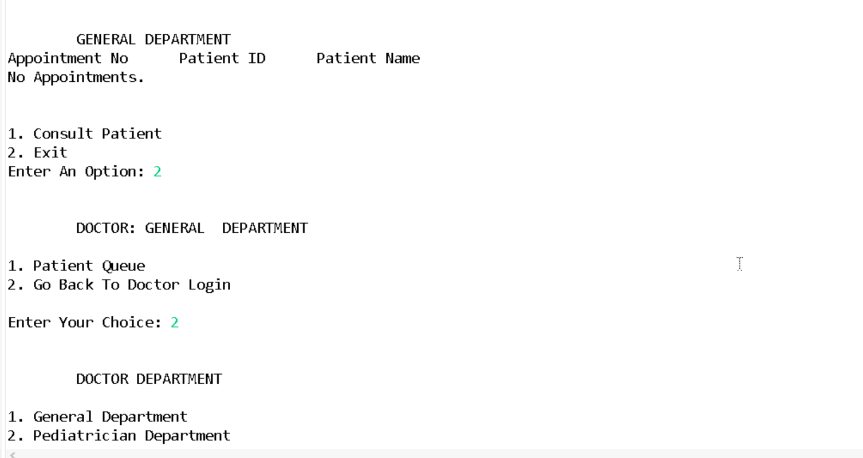

Slide 15
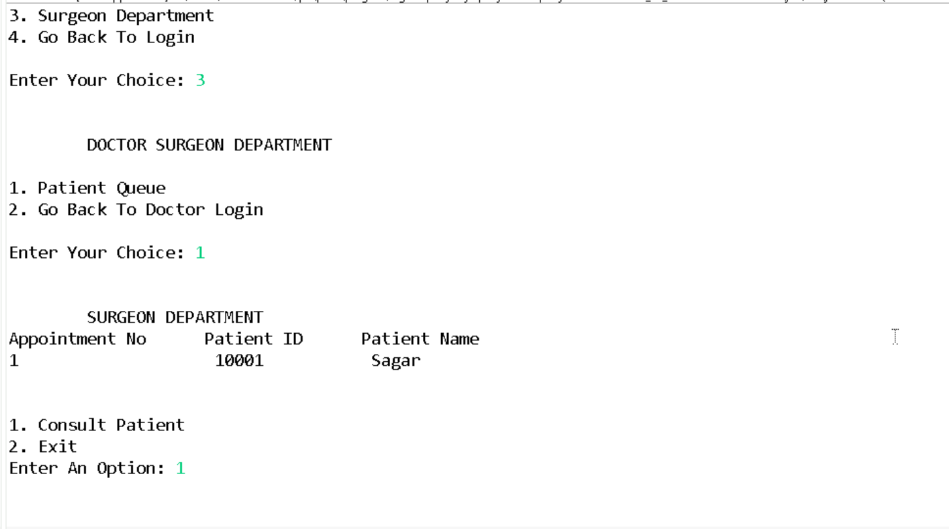
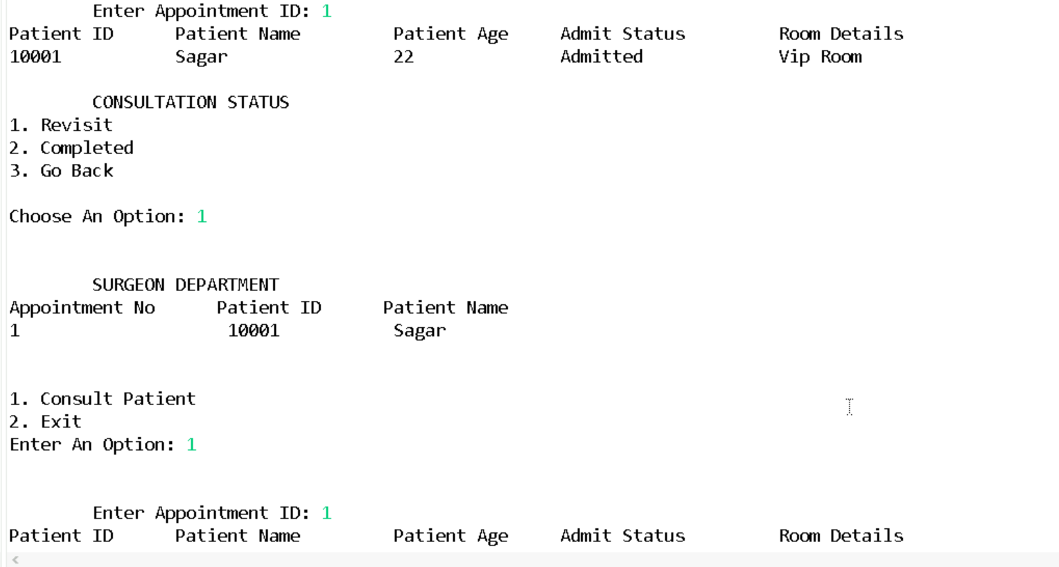

Slide 16
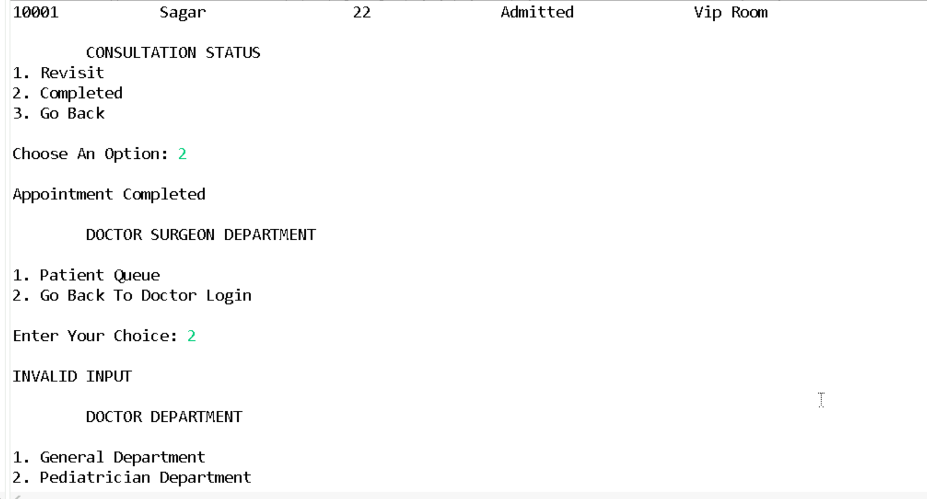
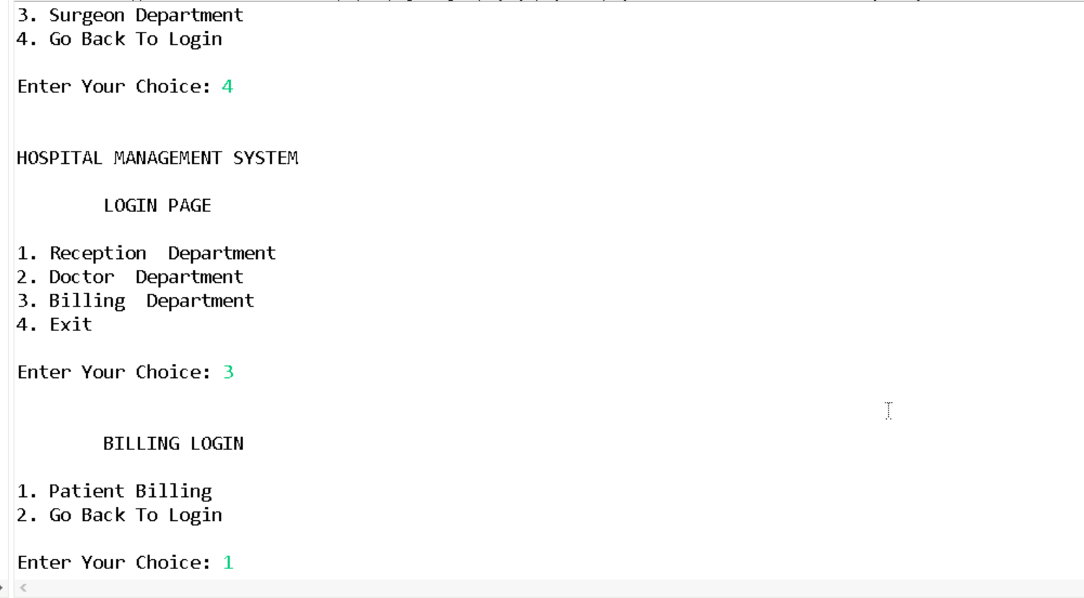

Slide 17
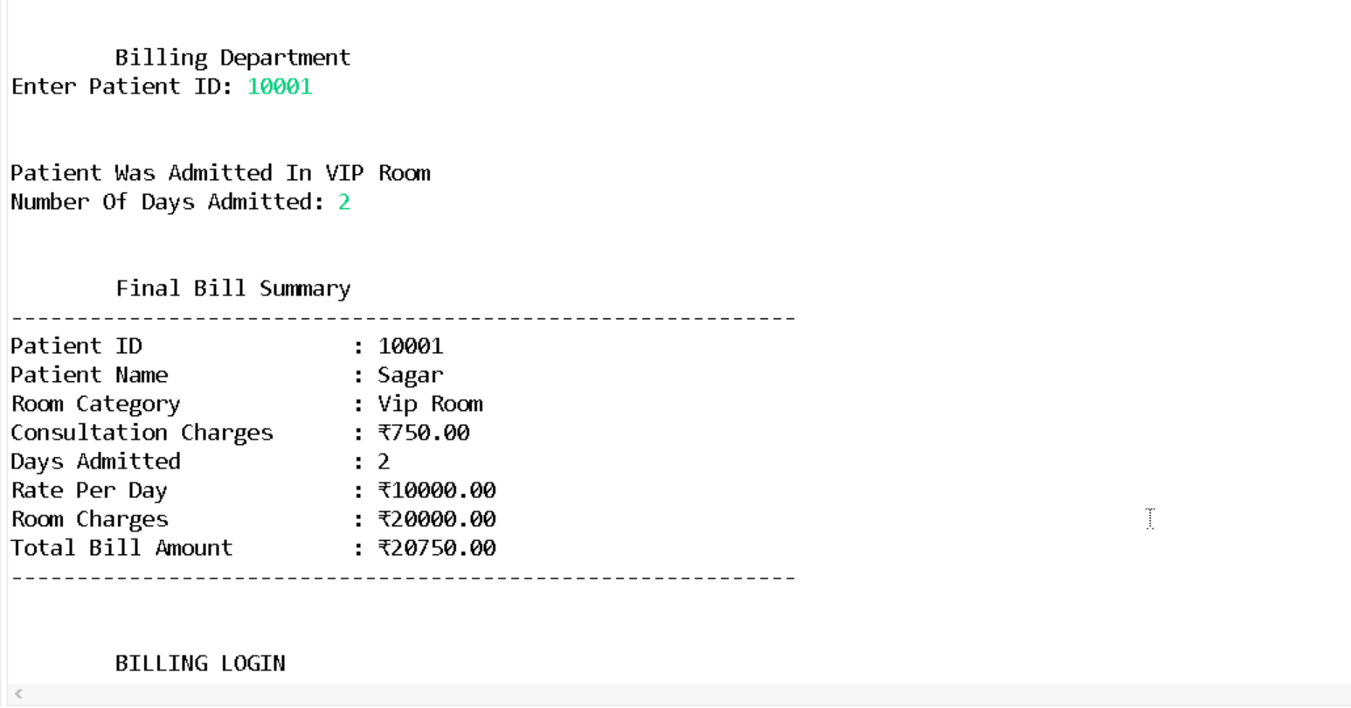
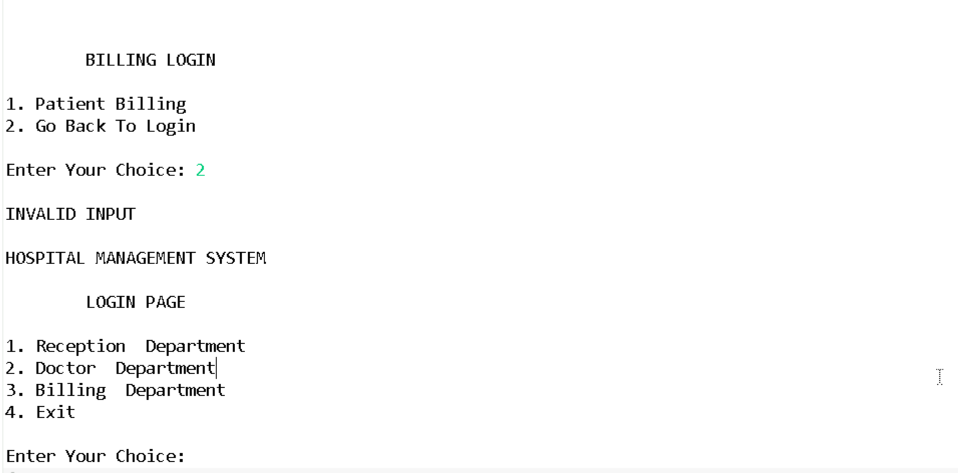

Slide 18
REPORT
1. Appointment Schedule Report
Displays all booked appointments for each doctor.
Includes patient name and token number.
Tokens are generated automatically during booking to maintain order and avoid confusion.
Helps receptionists manage patient flow efficiently.
2. Doctor’s Appointment View
Each doctor can access a personalized report showing:
  List of patients scheduled for the day.
  Appointment status (Completed, Revisit).
  Patient details linked to each appointment for quick reference.
Enables doctors to plan their day and prioritize cases.

Slide 19
REPORT
3. Patient Details Report
Comprehensive patient information including:
  Personal details (Name, Age).
  Bed allocation details.
Useful for both doctors and billing staff.
4. Billing Report
Summarizes all charges for services provided to the patient.
Includes:
  Consultation fees.
  Bed charges.
Generates a final invoice for patient discharge.

Slide 20
CONCLUSION
Provides a simple, role-based solution for hospital operations.
Improves efficiency, accuracy, and reduces manual workload.
Lays foundation for future enhancements like online booking, notifications, and integrated medical records.

